Slide 1
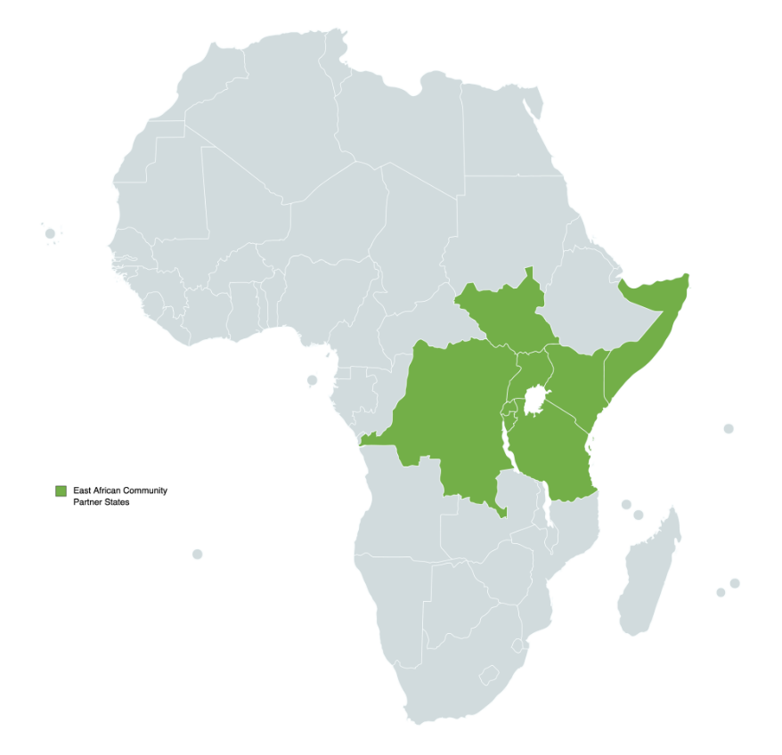

Slide 2
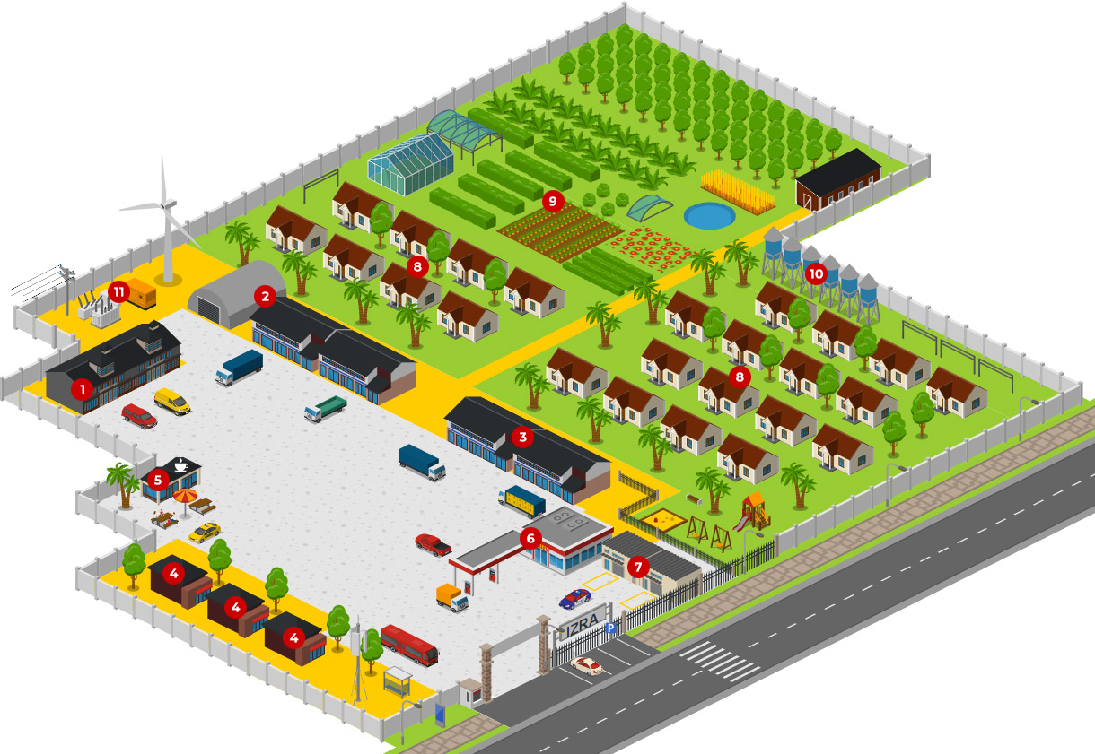
IZRA – INTERNATIONAL ZONE & RESIDENTAL AREA
LEGEND:
1 2 3 4 5 6 7 8 9 10 11
Offices Production Services Shops Restaurant, meeting point Petrol station Car / motorcycle service Residential complex Model agricultural land Water tanks Electric power supply + generator

Slide 3
www.ctcgroup.si
www.ctcgroup.co.ke

